Slide 1
Java Agents

Slide 2
Content
JVM architecture
Class loaders
Some examples
Java Agent
Java Instrumentation
Libraries that aid instrumentation (javaassist, ByteBuddy)
Writing your first Java agent
Native agents and Java agents
Examples of agent

Slide 3
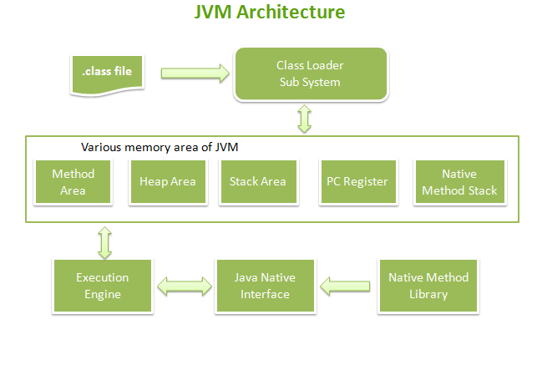

Slide 4
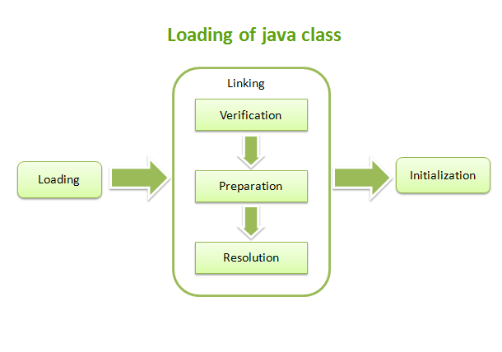
Class Loader Subsystem
Notes:
1. Class Loader SubSystem
Java’s dynamic class loading functionality is handled by the class loader subsystem. It loads, links and initializes the class when it refers to a class for the first time. Class loader sub system is responsible for following 3 activities
Loading :The Class loader reads the .class file, generate the corresponding binary data and save it in method area.
For each class file JVM will store corresponding information in method area, such as
Fully qualified name of class
Fully qualified name of immediate parent class
Methods info
Variable info
Constructor info
Modifiers info
Constant pool info
whether .class file represents class or Interface or enum
Linking : Performs verification, preparation, and (optionally) resolution.
Initialization : In this phase, all static variables are assigned with their values defined in the code and static block(if any). This is executed from top to bottom in a class and from parent to child in class hierarchy.

Slide 5
Class Loader Subsystem - Loading
Loading means reading class files from hard disk and store corresponding binary data in method area. For each class file JVM will store corresponding information in method area, such as
Fully qualified name of class
Fully qualified name of immediate parent class
Methods info
Variable info
Constructor info
Modifiers info
Constant pool info
whether .class file represents class or Interface or enum
After loading .class file immediately jvm creates an object for that loaded class on the Heap memory of type java.lang.Class.

Slide 6
Class Loader Subsystem - Linking
Linking consists of three activities
verify (LinkageError)
prepare (OutOfMemoryError)
resolve
Notes:
1. Verification
It is a process of ensuring that Binary representation of a class is a structurally correct or not.
JVM will check whether the .class file is generated by valid compiler or not.
.class file is properly formatted or not.
Internally Bytecode verifier is responsible for this activity.
Bytecode verifier is a part of Class Loader SubSystem.
If the binary representation of a class or interface does not satisfy the static or structural constraints then a VerifyError is thrown. An error thrown is an instance of LinkageError (or its sub class).
Variables are initialized before they are used.
Method calls match the types of object references.
Rules for accessing private data and methods are not violated.
Local variable accesses fall within the runtime stack.
The runtime stack does not overflow.
2. Preparation
In this phase, JVM will allocate memory for class level or interface level static variables and assign default values.
In initialization phase, original values will be assigned to the static variables and in preparation, only default values will be assigned.
3. Resolution
Resolution is the process of dynamically determining concrete values from symbolic references in the run-time constant pool. In simple words, it is the process of replacing symbolic names in our program with original memory references from method area.

Slide 7
Class Loader Subsystem - Initializing
Initialization : In this phase, all static variables are assigned with their values defined in the code and static block(if any). This is executed executed from top to bottom in a class and from parent to child in class hierarchy.

Slide 8
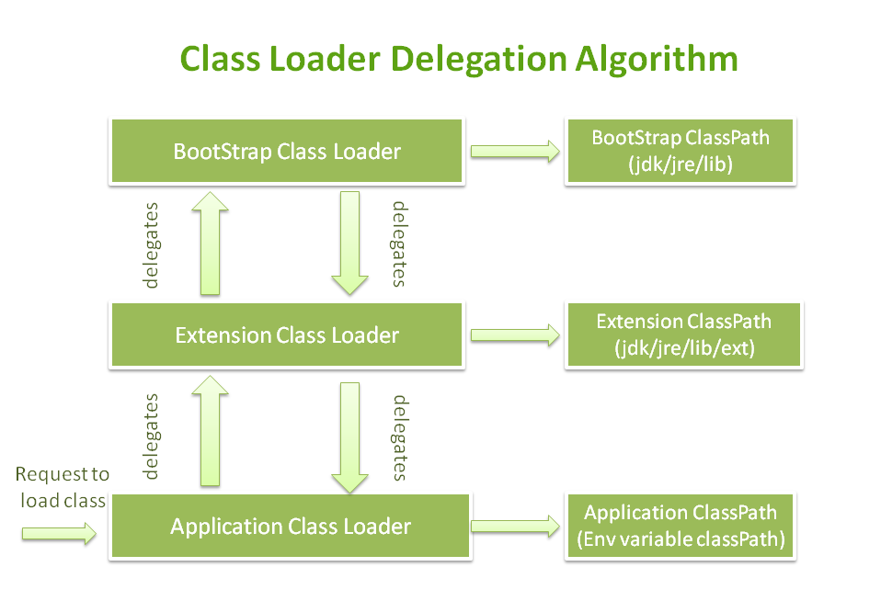
Types of Class Loaders
Java.lang. ClassNotFoundException

Slide 9
Why will you need to write custom class loaders ?

Slide 10
Problem !
Imagine you want to write a tool which records the parameters of a method and return values or records the entry and exit times of a method.
AOP ?
Needs you to change the source code
Notes:
The Instrumentation API offers a hook into the JVM runtime which allows Java agents to access more advanced features of the JVM. It also offers a hook into the JVM's class loading where an agent can be notified when a class is loaded and redefine its class file. Similary, it is possible to redefine/retransform already loaded classes.
AspectJ is a library that offers a more high-level view on redefining existing classses. It works with point cuts and join points to explain how a class should be redefined. The redefinition by AspectJ is then either applied at compile-time with the help of a tool like Maven or AspectJ can use a Java agebt and the instrumentation API to apply the redefinition of classes at runtime.

Slide 11

Java Agents
It is a thin layer between JVM and your application, separating application from underlying platform and gives you opportunity to be in middle of all things
$> java -javaagent:agent.jar Main
Notes:
Java agents are able to “intrude” into the execution of Java applications running on the JVM at runtime by performing the direct modifications of the bytecode.

Slide 12
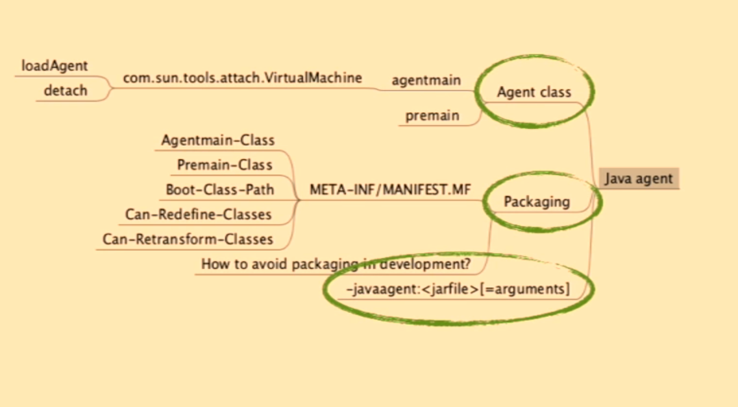
Java Agent Overview

Slide 13
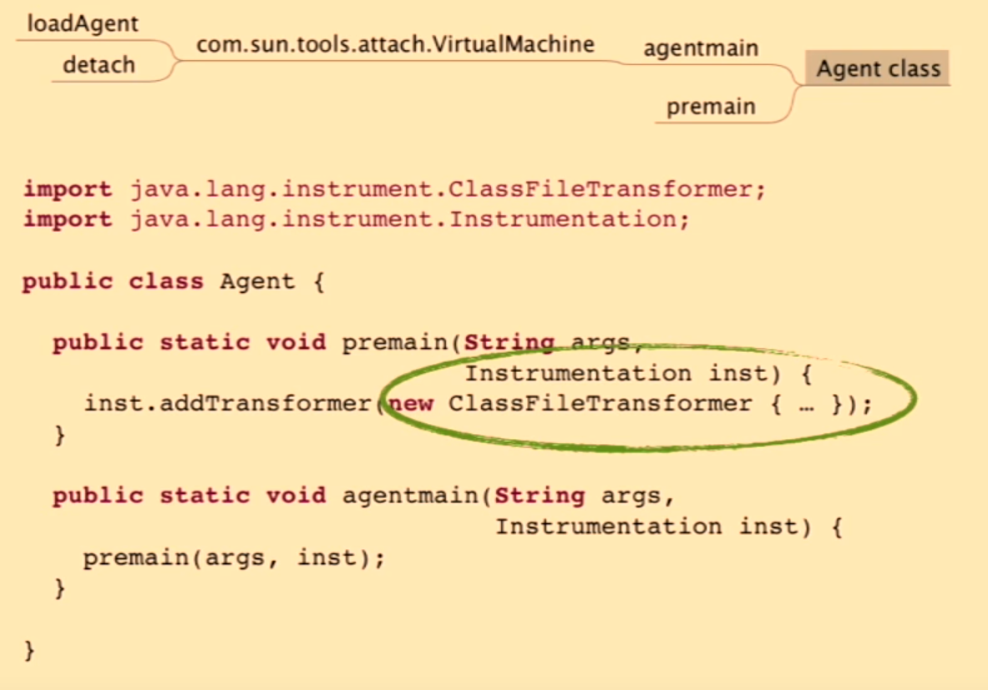

Slide 14
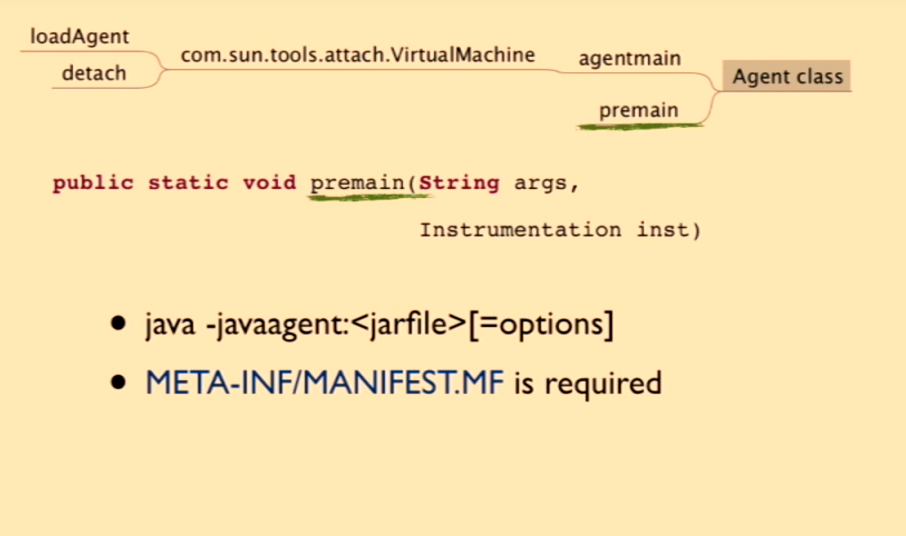

Slide 15
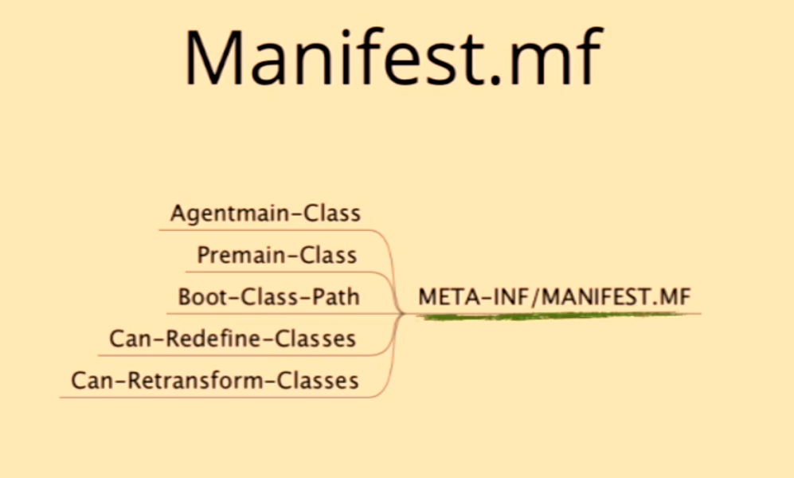
Notes:
Redefinition means that at an arbitrary point of time an agent will invoke Instrumentation. redefineClasses to change the actual definition of existing (and already loaded) classes. The agent will provide the bytecode for the new definition.
Retransformation refers to the process of class file transformation which is normally applied at class loading time. Agents can register ClassFileTransformers which are called one after another to apply transformations to the byte code before the class will be initialized. So Retransformation refers to the capability of the JVM to repeat this process for already loaded classes. In this case an agent may invoke Instrumentation.retransformClasses specifying which classes to retransform but no bytecode. Instead the JVM will call all registered retransforming capable ClassFileTransformers providing the actual bytecode (or the result of the previous transformer for a chained transformer).

Slide 16
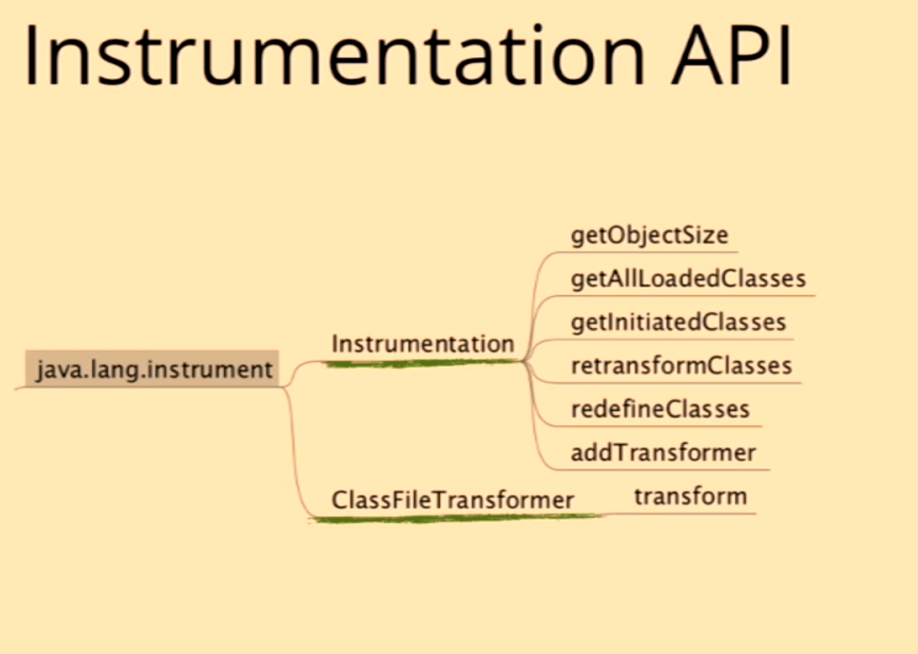

Slide 17
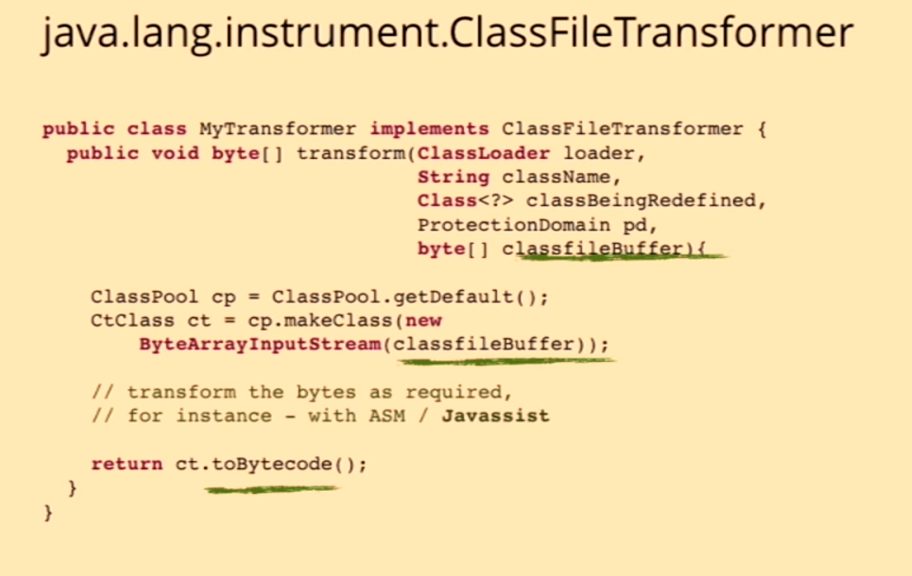

Slide 18
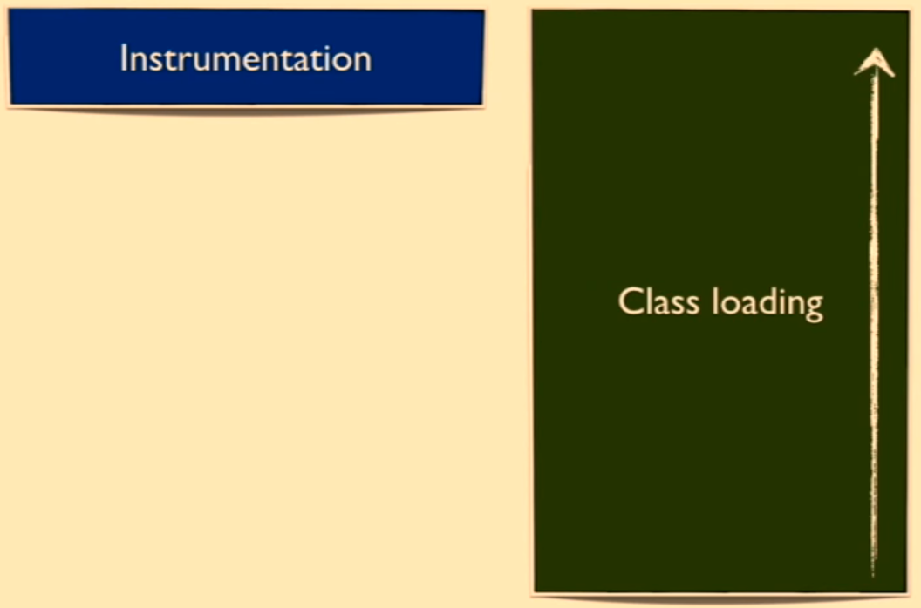

Slide 19
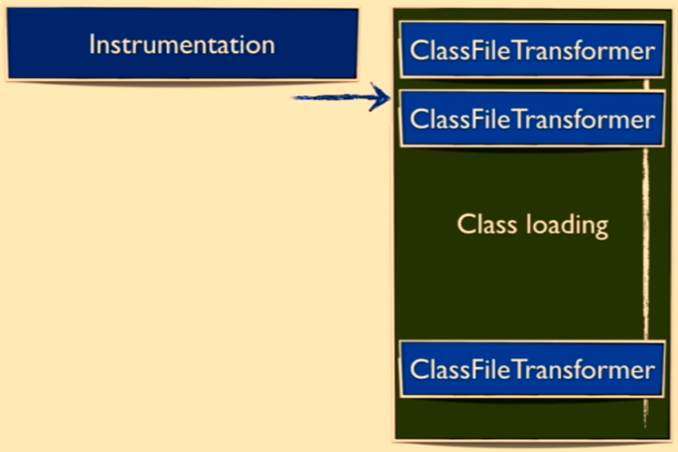

Slide 20
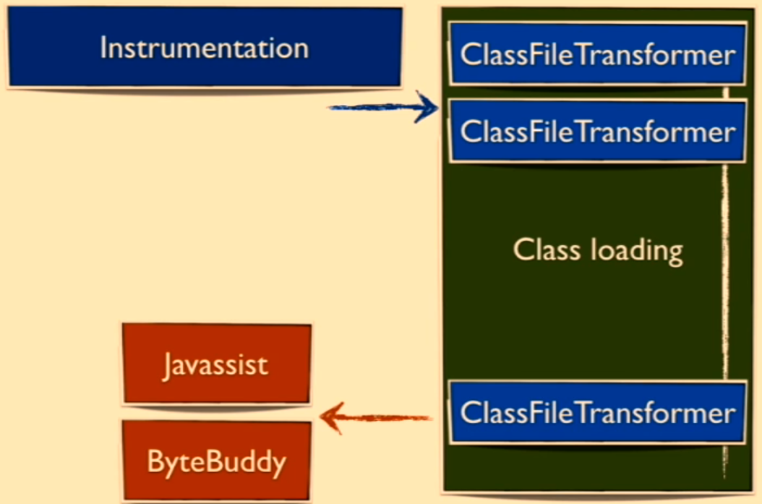

Slide 21
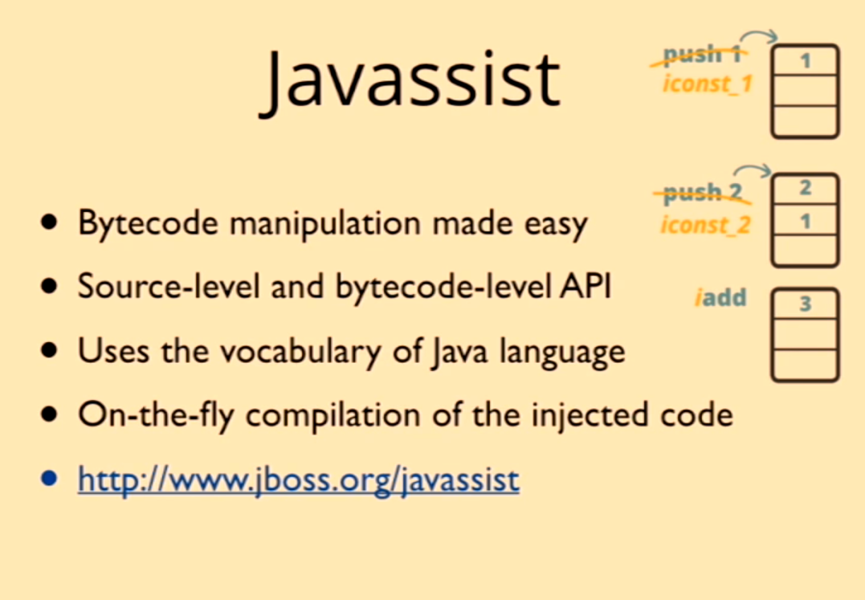

Slide 22


Slide 23
Lets see some code in action

Slide 24
Examples
Profilers use a Java agent to modify target framework’s code to inject new code that collects performance metrics. This includes both standalone or hosted services such as NewRelic or YourKit
JRebel took it to the next level by building a technology which provides smooth hot-swapping of classes at runtime without requiring JVM restarts
The Play framework uses a Java agent to enable hot-swapping of classes at run-time
At OverOps we leverage low-level capabilities provided by the JVM to native agents to show the actual source code and variables values which cause errors.

Slide 25
References
https://docs.oracle.com/javase/7/docs/platform/jvmti/jvmti.html
https://blog.takipi.com/double-agent-java-vs-native-agents
https://www.youtube.com/watch?v=tlcF8awgUEE
https://www.youtube.com/watch?v=39kdr1mNZ_s

